Slide 1
Textual Entailment
with TensorFlow
Amogh, Deexith & Vishwas
{avenka35,dmysor3,vsreev2}@uic.edu

Slide 2
Outline
Understanding textual entailment
Prerequisites
Word Vectorization using TensorFlow
Glove & SNLI
Overview of RNNs & LSTM
Regularization & Dropout
Code review
Applications and uses

Slide 3
Intro
Textual entailment is defined as a relation between two natural language sentences (a text T and a hypothesis H) that holds if a human reading T would infer that H is most likely true.
Introduced by Dagan et al. (2005) as a concept that corresponds to logical reasoning.
Notes:
Textual entailment in NLP is a directional relationship between text fragments.
It is formally def as the relation between a text and a hypothesis such that a human reading the T would infer that H is also true.

Slide 4
Intro
Example:
T = Brutus killed Caesar.
H = Caesar is dead.
It can be logically inferred from the given text that the hypothesis holds true.
The logical inferences are referred to as entailment.
Notes:
A person reading the text ___ can infer that the H is true. So this is a valid entailment.

Slide 5
Entailment
Formally, entailment is defined as any true inference from any given proposition.
The logical symbol for entailment is |=
If a given proposition(text) p is true, then it may entail many other propositions(q,r,s..)
For a proposition to entail any other proposition, a set of conditions have to be satisfied.

Slide 6
Entailment
p = Brutus killed Caesar
q = Caesar is dead
p |= q => p has to be true and q has to be true.
Entailment is a logical relationship between two propositions such that truth of p guarantees the truth of q. Also the falsity of q guarantees the falsity of p.
p |= q IFF p = true and q = true

Slide 7
Entailment relations
Positive entailment
It is basically a propositional hyponymy or a propositional synonymy.
T = Jack and Jill went up the hill
H = Multiple people went up the hill
Includes all cases of:
p |= q and q |= p (propositional synonymy)
p |= q (propositional hyponymy)
Notes:
There are 3 different types of entailment. This slide shows the example of positive entailment.
It includes all the cases of propositional synonymy and hyponymy.

Slide 8
Entailment relations
Negative entailment / Contradictions
Case of propositional antonymy
T = Two dogs played in the park with the old man
H = There was only one canine in the park that day
Includes all cases of:
p |= ~q (propositional antonymy)
Notes:
If two dogs were in the park then there must be at least 2 canines.
Includes all cases of prop antonymy.

Slide 9
Entailment relations
Neutral entailment
T = The kids love ice cream.
H = I played baseball with the kids
The first sentence says nothing about the truth or falsehood of the second—implying neutral entailment.
Notes:
Neither of the sentences say anything about the other.

Slide 10
Prerequisites
The article illustrates us how to build a simple neural network to perform textual entailment using TensorFlow.
We need:
TensorFlow version 1.0
Jupyter
Numpy
Matplotlib
TQDM
Notes:
The article that we’ll be talking about today shows us how to build a simple neural network to perform textual entailment using tensorflow.
Below are various tools that are required.
Moving forward, the article talks about a few important concepts that is used for entailment. We’ll look at them one by one.

Slide 11
Word Vectorization
What ? Why we need Word Vectorization?
Example:
Sentence 1 : Peter and Jade both were at the scene of the car crash.
Sentence 2: Multiple people saw the accident.
-> Car Crash = Accident?
Notes:
Before we begin -> Explain about the example, positive entailment

Slide 12
Word Vectorization
Example 2:
Sentence 1: Two dogs played in the park with the old man
Sentence 2: There was only one canine in the park that day
-> Canine = Dog??
So we express words as numbers. But why? How?
Notes:
Before we begin -> Explain about the example, negative entailment

Slide 13
Word2Vec model by Mikolov et al
Why learn word embeddings?
Vector Space Models
Count Based Methods
Predictive Methods
Continuous bag of wards Model
Skip-gram Model

Slide 14
Word Vectorization
Representation of words in a high-dimensional vector space
Expressing word as numbers – character code
Canine – ID1578
Dog – ID1169
Word2Vec Model – Mikolov et al
Model is used for learning vector representations of words, called "word embeddings".
Notes:
Neural network mainly deals with the numbers so
Techniques

Slide 15
Word Vectorizaton
NLP systems treats words as discrete atomic symbols.
Unique discrete ID’s lead to data sparsity => more data to train
Vector Space Model
Count-based Method
Predictive Method
Notes:
Example Cat as ID15477 and Canine as ID1655. these IDs are arbitrary and provide no info abt these words relations
More data to train statistical models. Thus using the vector representation we can easily over come this.
Thus the VSM represents words in a continuous vector space
Count based- works by computing the statistics as how often some word co-occurs with its neighbor word in a large text corpus, then all these count-statistics down to a small, dense vector for each word.
Predictive model directly try to predict a word from its neighbors in terms of learned small dense embedding vectors.

Slide 16
Word2Vec
Computationally efficient predictive model for learning word embeddings from the raw text.
Two Flavors:
Continuous Bag of Words Model (CBOW)
Skip-gram Model
Notes:
Both are algorithmically similar but only diff is that CBOW predicts target words and skip-gram context words
Thus skip gram treats each context target pair as a new observation and tends to do better when we have a large data set

Slide 17
The Skip-gram Model
Ex:
the quick brown fox jumped over the lazy dog
Data Set :
([the, brown], quick), ([quick, fox], brown), ([brown, jumped], fox), ...
Skip-Gram Model:
(quick, the), (quick, brown), (brown, quick), (brown, fox), ...
Notes:
We first form a data set of words and contexts.
Contexts can be anything like words to left or words to oly right to right or left
We will use the vanilla definition of the words as left and right.
We get the context-target pairs
Skip-grams inverts so we get as shown. Input-output pairs

Slide 18
Word Vectorization with TensorFlow

Slide 19
GloVe: Global Vectors for Word Representation
Unsupervised learning algorithm for obtaining vector representations for words.
The GloVe model is trained on the non-zero entries of a global word-word co-occurrence matrix, which tabulates how frequently words co-occur with one another in a given corpus.

Slide 20
GloVe: Global Vectors for Word Representation
Nearest Neighbor:
Frog – frogs – toad – Litoria – rana – lizard
Euclidean Distance or Cosine similarity
Linear Substructure
Similarity metrices produce a single scalar that quantifies the relatedness of words
Example:
Man = Women => Human beings
Man X Women => Gender
Notes:
But this seems problematic as given two words they might exhibit more intricate relationships that might not be captured by the single number.
Man can be regarded as similar to women as both belong to human beings. Other hand both as opposite when we compare man and women wrt gender
Inorder to catch this small quantitative distingusibility of man from women it is necessary for a model to associate more than a single no to a word pair.

Slide 21
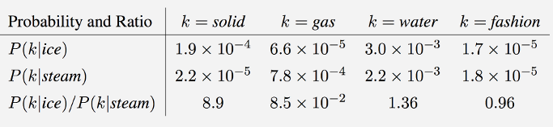
GloVe: Global Vectors for Word Representation
Model overview: Here are some actual probabilities from a 6 billion word corpus:
Notes:
The co-occurance of probabilities of target word Ice and steam is given
Ice occurs mainly with solid and steam with gas
Also both occurs with water and infrequently with the unrelated word fasion
Thus by taking the ratios, we can easily cancel out the unrelated words as water and fashion Thus is is how the model is trained in Glove

Slide 22
The Stanford Natural Language Inference (SNLI) Corpus
Supporting the task of natural language inference (NLI), also known as recognizing textual entailment (RTE).
Collection of 570k human written English sentence pairs manually labeled.

Slide 23
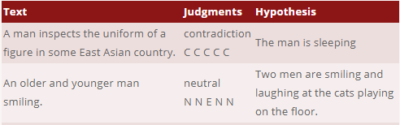
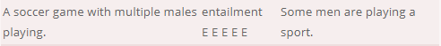
SNLI
Sample:

Slide 24
Working with Stanford’s GloVe word vectorization + SNLI data set
The code is designed to work with the pre-trained data for Stanford’s GloVe word vectorization.
We’ll be using the six-billion-token Wikipedia 2014 + Gigaword 5 vectors among others (Common Crawl, Twitter etc).
We'll be using the development set in the interest of speed (it has only 10,000 sentence pairs)

Slide 25
MultiNLI
Modeled over SNLI
Collection of 433K sentence pairsre
Only difference with SNLI is “Genres”
Notes:
This multiNLI covers a range of genres if spoken & written text and supports a distinctive cross-genre generalization evaluation

Slide 26
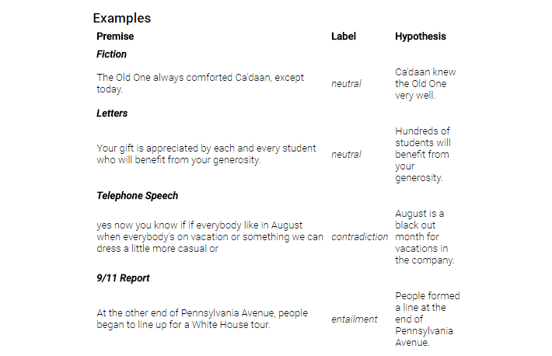
MultiNLI
Notes:
The

Slide 27
Vanilla RNNs & vanishing gradient problem
In practice, earlier data is completely drowned out by newer inputs and information that doesn’t end up being nearly as important.
Recurrent neural networks often fail to hold on to information for long periods of time and is known as the vanishing gradient problem.
Since we want to keep track of both sentences in the input pair, vanilla RNNs is not suitable.
Simplest solution is to use the LSTM.
Notes:
The article talks about how the computer visualizes the word vectorization. We’ll be looking at that when we review the code.
The next thing it talks about is the kind of network that is required for the task.
So unlike images, text can be sequential and cannot be constrained by size.
So instead of fully connected forward-feeding networks that take in one input value and simply run until it produces a single output, we need a recurrence network.
Recurrent Neural Network is a class of neural networks whose connections between neurons form a directed cycle.
Unlike feedforward neural networks, RNN can use its internal “memory” to process a sequence of inputs, which makes it popular for processing sequential information.
The main problem with this form of recurrence is that, in practice, earlier data is completely drowned out by newer inputs
RNNs often fail to hold on to information for long periods of time and is known as the vanishing gradient problem.
Since we want to keep track of both sentences in the input pair, RNN is not suitable.
We need something different and the simplest solution is to use LSTM.

Slide 28
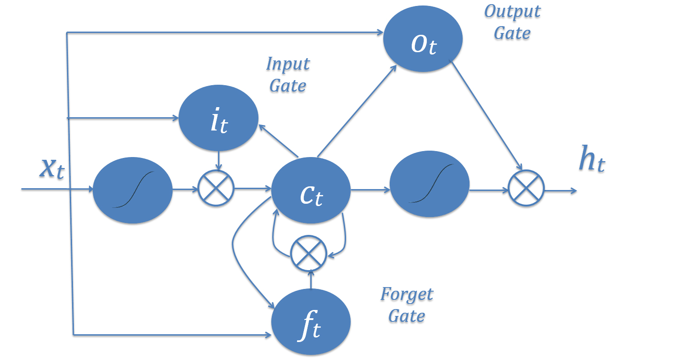
Utilizing LSTM
The network makes a decision on how much the current values can affect the memory by an “input gate” (it).
Makes another decision on what memory (ct) is forgotten by an appropriately named “forget gate” (ft).
Finally makes a third decision on what parts of memory are sent to the next timestep (ht) by an “output gate” (ot).
Notes:
Long Short Term Memory network (LSTM) is a special type of RNN, which is capable of learning long-term dependencies.

Slide 29
Need for regularization
The network might read a lot of meaning into common, but inconsequential, words like “a,” “the,” and “and.”
The network might incorrectly output negative entailment if one sentence uses the phrase “an animal” and the other uses “the animal”.
We need to regulate to see if individual words end up being important to the meaning as a whole.
Notes:
If we use just LSTM layers and nothing more, the network might read a lot of meaning into common words and the model might become overfitting.
The network might also not be able to differentiate between phrases “an animal” & “the animal”.
So we need some modification that reduces the generalization error and that is obtained by regularization.

Slide 30
Implementing dropout
Dropout is a regularization pattern in neural network design that revolves around dropping randomly selected hidden and visible units.
Dropout on “standard” layers is useful as it effectively trains multiple smaller networks and then combines them.
A dropout layer has one hyperparameter known as p - probability that each unit is kept in the network for that iteration of training.
Notes:
There are various techniques of regularization and the article talks about one called the dropout technique.
Dropout is a pattern that randomly drops different units from the LSTM layer.
It is very efficient because it trains multiple smaller networks and then combines them.
It has a hyperparameter p- which is the probability that a unit is kept during the training for a given iteration.

Slide 31
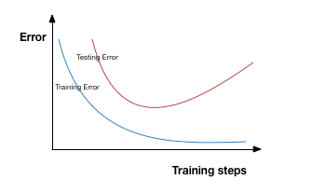
Implementing dropout
Overfitting symptom: Testing error >> Training error

Slide 32
Implementing dropout
Dropout layer with probability of keeping 0.5

Slide 33
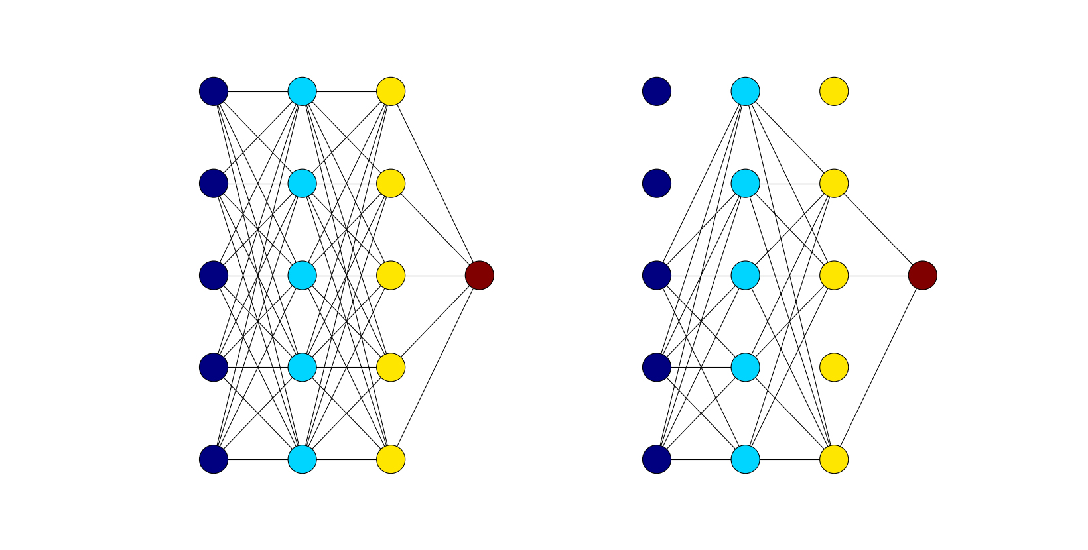
Implementing dropout
Shows the difference between a fully connected network without dropout and a fully connected network with dropout during one iteration of training.

Slide 34
Applications
A very useful component in much larger applications.
Question-Answering systems may use textual entailment to verify an answer from stored information.
Textual entailment may also enhance document summarization.
Typically entailment is used as part of a larger system, for example in a prediction system to filter out trivial or obvious predictions.

Slide 35
QA Systems
“Methods for Using Textual Entailment in Open-Domain Question Answering”
https://aclanthology.info/pdf/P/P06/P06-1114.pdf
About Open-Domain Q/A systems.
How does a Q/A system work?
Notes:
Accuracy 20%
So open domain q/a systems returns a textual expression which is identified from a vast document collection as a response to a question asked in a NL

Slide 36
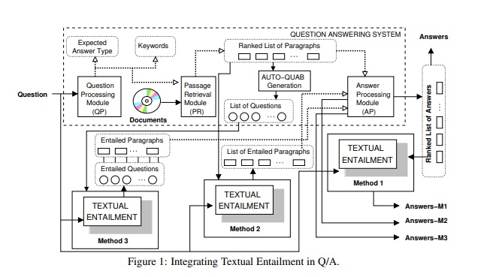
Integrating TE in Q/A
Notes:
Qp – question submitted and extract a set od relevant words EAT to PR then AP
PR
AP
Method-3 : Question ?q logically entails another question ?q’

Slide 37
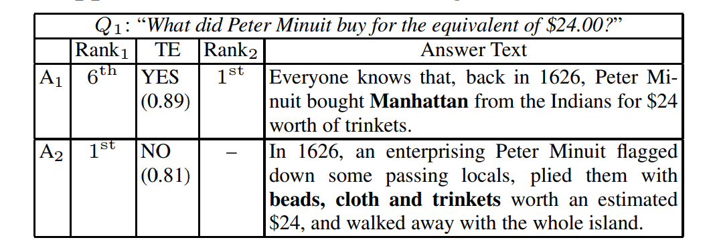
Different Q/A methods:
Method 1:

Slide 38
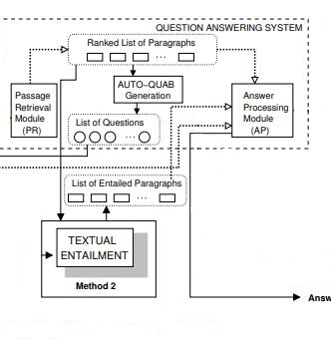
Method 2:

Slide 39
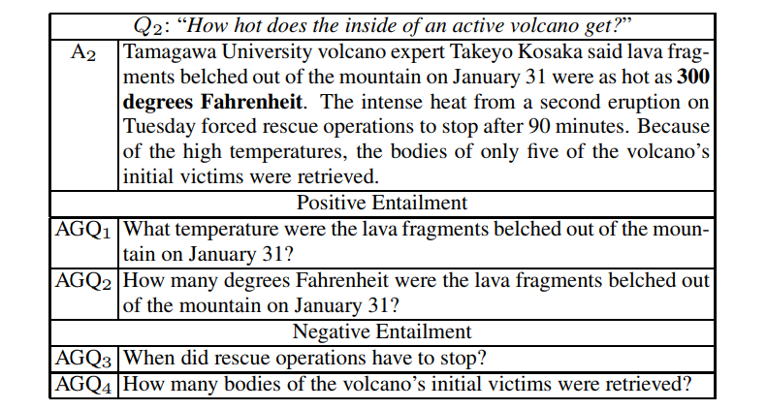
Method 3:

Slide 40
Text summarization
“A Text Summarization Approach under the Influence of Textual Entailment”
https://pdfs.semanticscholar.org/a75a/2e8ebdd452234658b884d73fadd5bec0a9e1.pdf
A summary can be defined as a text that is produced from one or more texts, that contains a significant portion of the information in the original text(s), and that is no longer than half of the original text(s).
Notes:
The aim of this paper is to show a study on how textual entailment influences text summarization.
Summary
Follows 2 techniques.

Slide 41
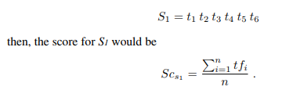
Text summarization
Use two different resources to generate extracts of single documents: word-frequency and textual entailment.
Word-Frequency: Employ a technique based on the word’s frequency which assumes that the more times a word appears in a document, the more relevant become the sentences that contain this word.
Notes:
In word frequency technique, they take the word count and then find out the frequencies. Calculate sentence scores. TFi is frequency of the word and n is length of the sentence without stopwords.

Slide 42
Text summarization
TEXTUAL ENTAILMENT:
The main idea here is to make up a preliminary summary by the sentences of the text that does not hold an entailment relation.
The final summary obtained by the processed entailment inferences comprises the sentences that are not entailed by the accumulated summary of the previous non-entailed sentences (i.e S1, S2, S3 and S6 regarding the above example)
Notes:
The main idea in entailment technique is to create a summary by choosing sentences that does not hold an entailment relation.

Slide 43
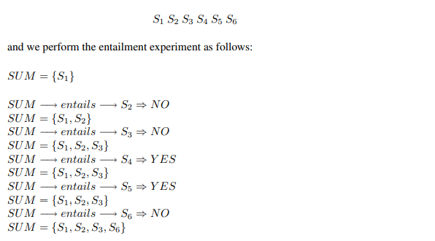
Text summarization

Slide 44
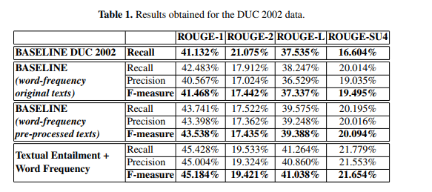
Text summarization
Notes:
Rouge is the tool used for analysis. We can see that the performance measures increase with entailment.

